Slide 1
课时分层检测九

Slide 2
完形填空
I went out to dinner at a chain restaurant. I’m blind but I didn’t want to trouble anyone. Out of 1 , my walking stick was beside my right hand. The restaurant had braille (盲文) menus — most chains do — so I 2 asked for one.
I was truly amazed by the thoughtful 3 given to me. The waitress took my hand and guided me to sit at the table. Then she got everything for me, and 4 while I read the list for what I wanted.
Then, as I 5 my steak, politely and without any feeling of 6 , she asked if I wanted my steak to be 7 . I can use knife — not well, but I can do this. I have never felt so 8 in my life.
This also included how she led me to the restroom as a sighted 9 . I grabbed her arm, walking half a 10 behind her. She even placed my hand on my chair when we got back.
Unfortunately, not all of us are greeted warmly when we go to a dining spot. I once experienced a particularly 11 service, for which my heart 12 a little. Now I was deeply moved and started crying. She placed her hand on my shoulder in a 13 manner.
I made sure the woman’s manager was informed about how 14 she was. I tipped her, but she wouldn’t take it. I ended up 15 it gently into her hand.

Slide 3
选项
1.A．schedule | B．habit | C．concern | D．custom
2.A．impatiently | B．cautiously | C．casually | D．politely
3.A．field | B．course | C．program | D．service
4.A．waited | B．left | C．apologized | D．checked
5.A．cooked | B．prepared | C．ordered | D．delivered
6.A．embarrassment | B．loneliness | C．gratitude | D．enthusiasm
7.A．sent off | B．paid back | C．cut up | D．packed away
8.A．respected | B．rewarded | C．discouraged | D．confused
9.A．manager | B．customer | C．guest | D．guide
10.A．spot | B．step | C．route | D．minute
11.A．doubtful | B．sympathetic | C．unpleasant | D．optimistic
12.A．shone | B．cooled | C．warmed | D．broke
13.A．regretting | B．comforting | C．forgiving | D．upsetting
14.A．wonderful | B．intelligent | C．generous | D．confident
15.A．lifting | B．leading | C．pressing | D．throwing

Slide 4
中文翻译
我去一家连锁餐厅吃饭。我是盲人，但我不想麻烦任何人。出于习惯，我的盲杖放在右手边。餐厅有盲文菜单——大多数连锁店都有——所以我礼貌地要了一份。
服务员对我的周到服务让我真心感到惊讶。她拉着我的手，引导我就座。然后她帮我把所有东西都准备好，并在我阅读菜单挑选想吃的东西时等候在一旁。
接着，当我点牛排时，她礼貌地、没有任何尴尬感地问我是否想把牛排切好。我可以用刀——虽然用得不太好，但我能行。我一生中从未感到如此被尊重。
这还包括她作为视力正常的向导带我去洗手间。我抓着她的胳膊，在她身后半步步的距离走着。回来时她甚至把我的手放在我的椅子上。
不幸的是，并不是我们所有人在去餐厅时都会受到热情接待。我曾经经历过一次特别不愉快的服务，那次让我的心碎了一些。而这次我深受感动，开始哭了起来。她以安慰的方式把手放在我的肩膀上。
我确保让那位女士的经理知道她有多么出色。我给她小费，但她不肯收。最后我轻轻地塞进了她手里。

Slide 5
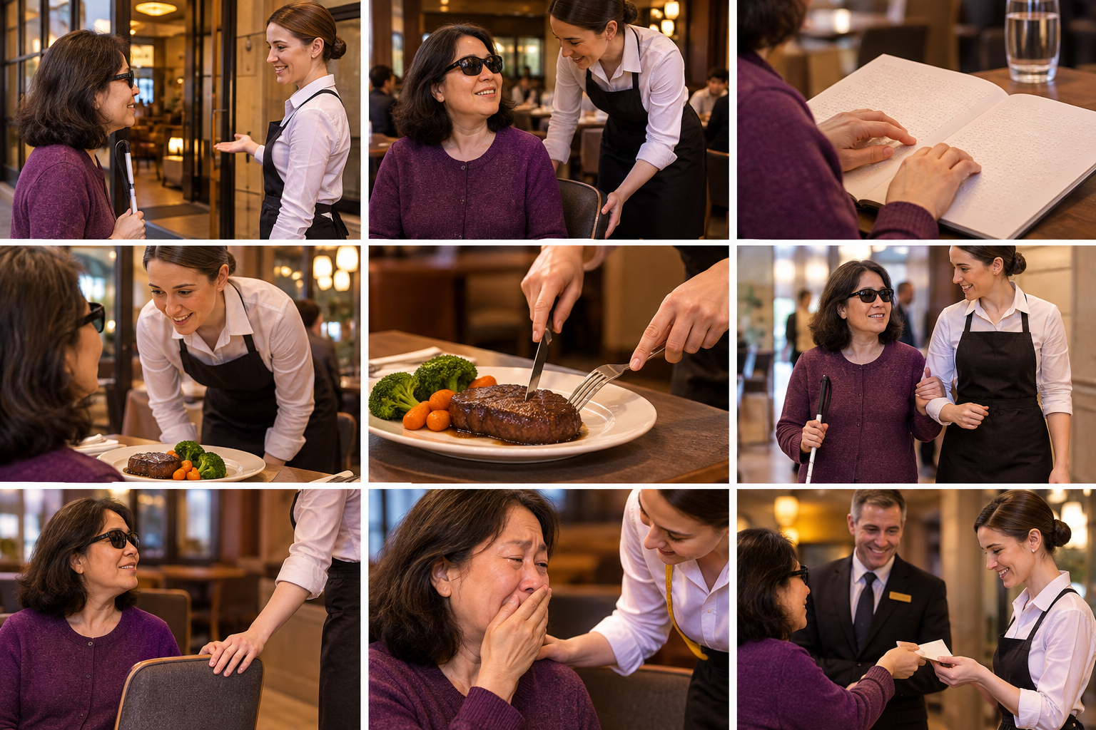
叙事流程图
arrived at the restaurant
ordered food
cut food
went to a restroom
cried because moved
gave tip

Slide 6
A. 动词与动词短语 (Verbs & Phrasal Verbs)
1 | trouble (v.) | 麻烦；打扰 | I didn't want to trouble anyone.
2 | guide (v.) | 引导；带领 | She guided me to sit at the table.
3 | order (v.) | 点（餐） | I ordered my steak.
4 | cut up | 切碎 | She asked if I wanted my steak cut up.
5 | grab (v.) | 抓住 | I grabbed her arm.
6 | tip (v.) | 给小费 | I tipped her.
7 | press (v.) | 按；塞 | I pressed it gently into her hand.
8 | end up doing | 最终做了某事 | I ended up pressing it into her hand.
9 | make sure | 确保 | I made sure the manager was informed.
10 | be informed about | 被告知 | The manager was informed about it.

Slide 7
B. 形容词 (Adjectives)
11 | thoughtful | 周到的；体贴的 | the thoughtful service
12 | respected | 受尊重的 | I have never felt so respected.
13 | unpleasant | 不愉快的 | a particularly unpleasant service
14 | comforting | 安慰的 | in a comforting manner
15 | sighted | 视力正常的 | as a sighted guide
16 | amazed | 惊讶的 | I was truly amazed.

Slide 8
C. 副词 (Adverbs)
17 | politely | 礼貌地 | politely asked for one
18 | truly | 真正地 | I was truly amazed.
19 | gently | 轻轻地 | gently into her hand
20 | particularly | 特别地 | a particularly unpleasant service

Slide 9
C. 名词 (Nouns)
21 | habit | 习惯 | Out of habit
22 | embarrassment | 尴尬 | without any feeling of embarrassment
23 | service | 服务 | the thoughtful service
24 | guide (n.) | 向导 | as a sighted guide
25 | manner | 方式 | in a comforting manner

Slide 10
单项选择练习
1. ______ habit, I put my walking stick beside my right hand.
A. Out of B. Because of C. Instead of D. In front of
2. The restaurant had braille menus, so I ______ asked for one.
A. impatiently B. politely C. casually D. cautiously
3. I was truly amazed by the thoughtful ______ given to me.
A. field B. course C. program D. service
4. She got everything for me and ______ while I read the menu.
A. waited B. left C. apologized D. checked
5. As I ______ my steak, she asked if I wanted it cut up.
A. cooked B. prepared C. ordered D. delivered

Slide 11
单项选择练习
6. "Out of habit" most nearly means ______.
A. by accident B. because of a regular pattern C. in a hurry D. with difficulty
7. "I was deeply moved" means the author felt ______.
A. angry B. emotionally touched C. confused D. tired
8. A "sighted guide" is someone who ______.
A. cannot see B. can see and leads a blind person C. serves food D. manages the restaurant
9. "In a comforting manner" means ______.
A. in a way that makes someone feel better B. in an angry way C. in a careless way D. in a hurry
10. The opposite of "politely" is ______.
A. kindly B. rudely C. gently D. thoughtfully

